Slide 1

Donor Data Analysis
March 2017

Slide 2
Note
Fiscal Year = June 1st to May 31st
Amounts are in Hong Kong Dollars

Slide 3
Newly Acquired Households
FY | Total Households Newly Donated | Gave in subsequent years
2017-18 | 88 | -
2016-17 | 713 | 63
2015-16 | 390 | 102
2014-15 | 639 | 136
2013-14 | 1,684 | 213
FY | Total Households Newly Donated | Gave in subsequent years
2016-17 | 856
2015-16 | 505
2014-15 | 745
2013-14 | 1,697
Notes:
New slide for newly acquired
How much did they gave
How many
Did they give again
Vs only gave once?

Slide 4
Meetings and Yearly Giving
How many meetings were held?
Did people give more or less in number of transactions and total amount based on how many meetings they had?

Slide 5
Yearly Comparison
FY | Donations From Individuals HK$ | Average Amount/ Household | Total # of Individual Contacts | Current Year Active Households | Total Households | Total Households Newly Donated | Previous Donor Household Drop-off
2016-17 | $27,563,951 | $22,893 | 16,428 | 1,204 |  | 856 | 392 (year not over)
2015-16 | $34,175,771 | $40,112 | 14,297 | 852 |  | 505 | 572
2014-15 | $36,102,850 | $32,910 | 12,379 | 1,097 |  | 745 | 1,402
2013-14 | $31,430,201 | $14,326 | 10,264 | 2,194 |  | 1,697 | 434
Notes:
20170601
Total households newly acquired that gave
How many gave in the years after?
Total # of Contacts – Used Created Date
Previous Donor Drop-off – Gave in previous year but did not give this year
Total Donors Newly Acquired (1st Gift in a certain FY)

Slide 6
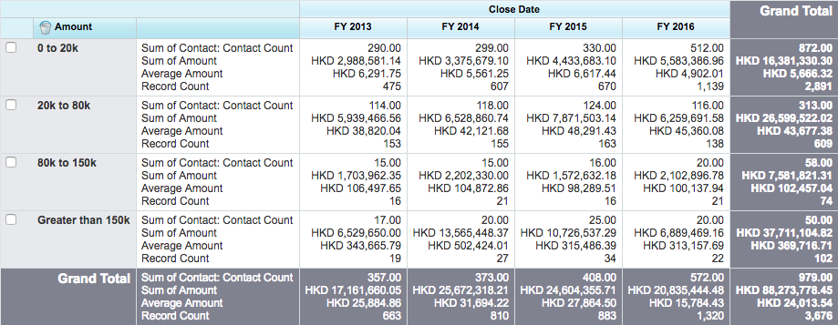
Individual Donations Over Time
Notes:
Household count?
Household giving vs transactions
Allocations of the donations
Contact Count – Number of unique donors
Record Count – Number of donations (transactions)
Notes:
Any potential to move 0-20k donors to higher as they are the largest pool of people?
Any potential to move 20k – 70k donors up?
Decrease in 20-70k donors over the years
Stagnant Greater than 100k but perhaps they are different people? Look at who these people are?

Slide 7
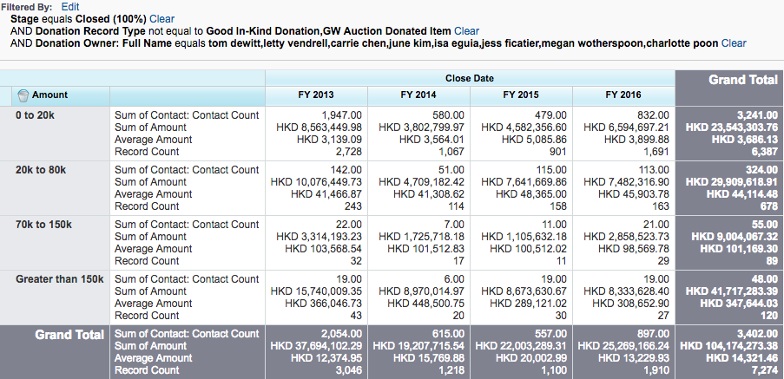
Donor Relations Portfolios
Notes:
Add just individuals?
2016 0-20k contact count? Should be smaller
Same thing for people who been met.

Slide 8
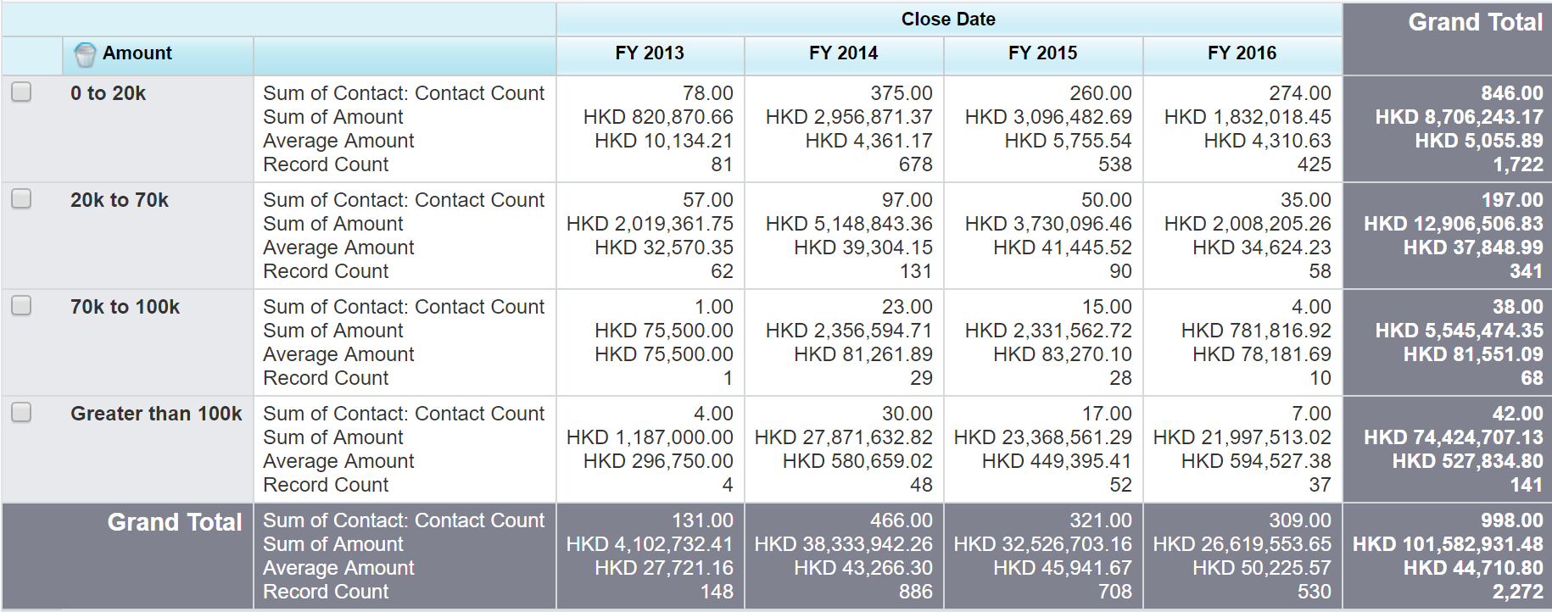
Donations without Donor Managers
Notes:
Separate organizations from individuals on the DR team
https://ap1.salesforce.com/00O90000009VrNQ

Slide 9
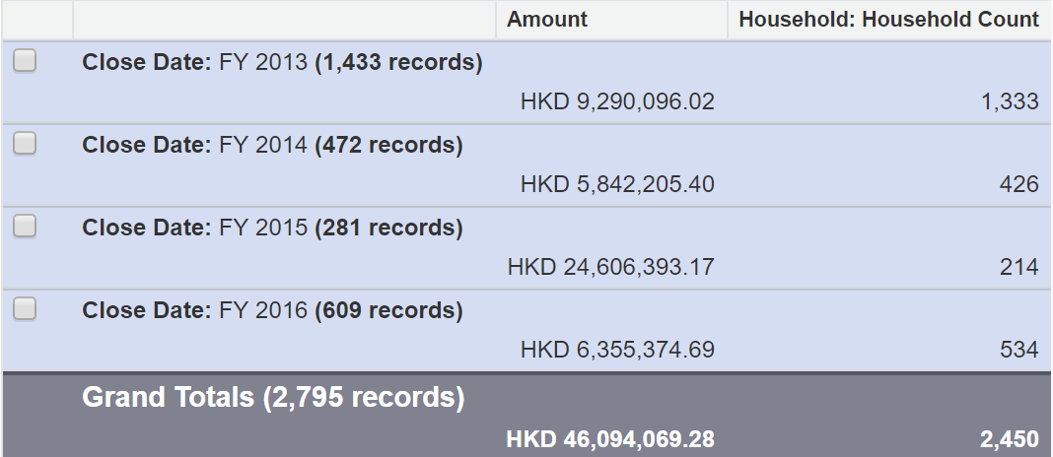
Households that gave only once
Notes:
2015 outlier
Make Tabular, Export to Excel to create chart

Slide 10
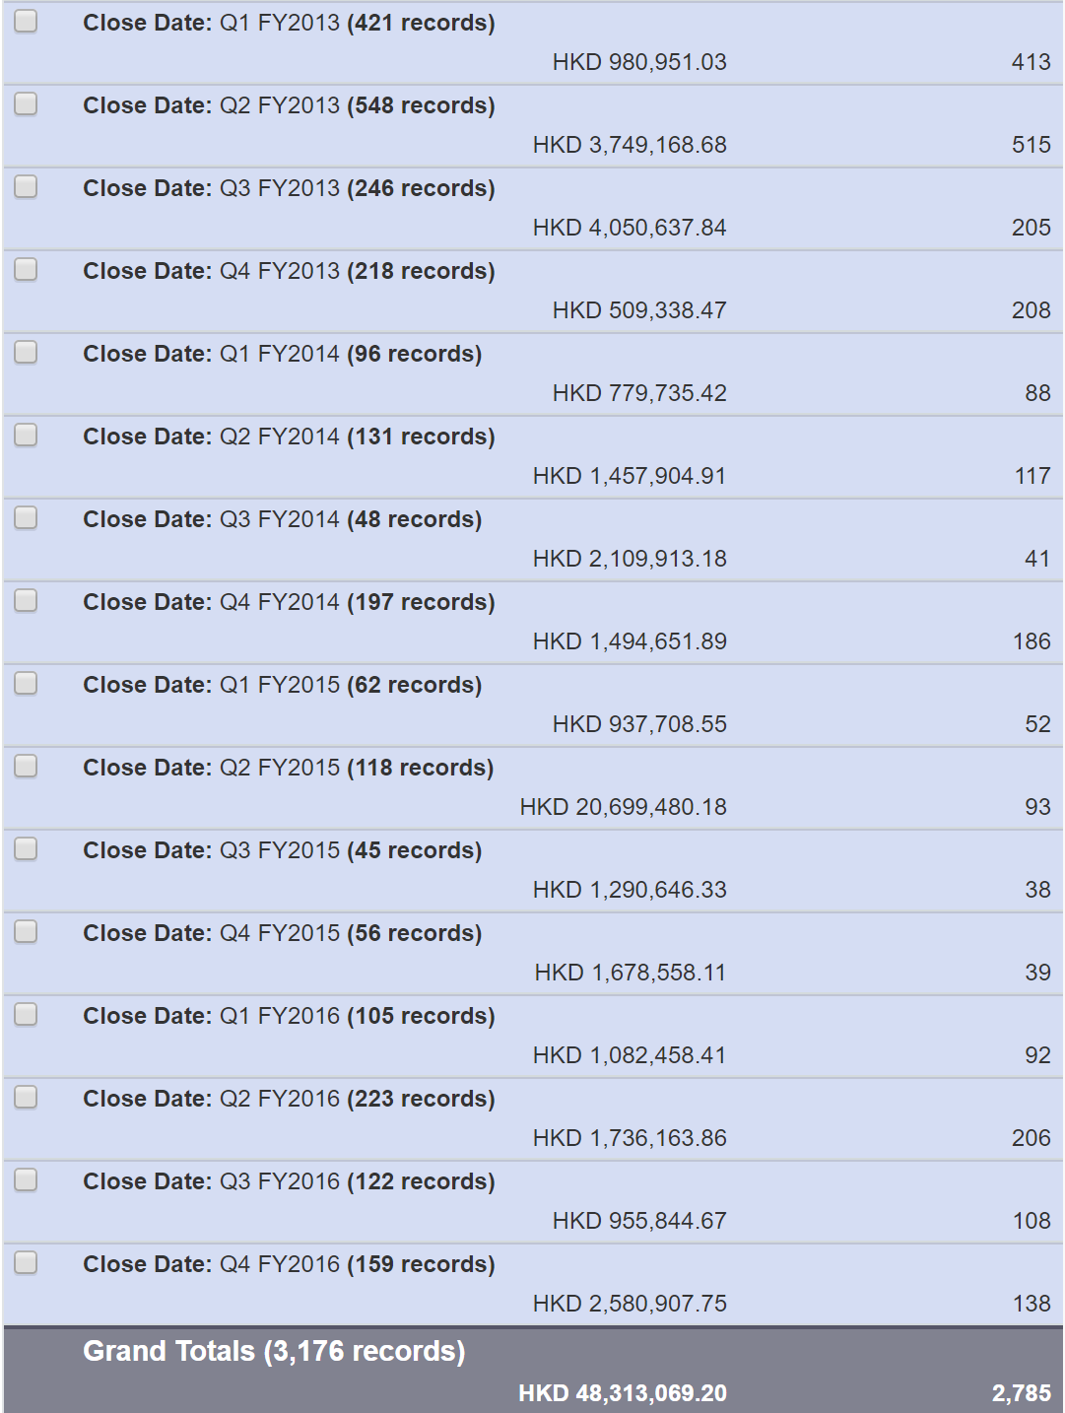
Household that gave only once by Fiscal Quarter
Notes:
Only look at Q4 or October? + heading? Compare with total giving by qtr

Slide 11
Banquet Attendance
Banquet Year | Attendees | Households that donated One Gift Only at banquet
2016 | 864 | 143
2015 | 842 | 66
2014 | 852 | 74
2013 | 858 | 118
Notes:
20170601
Households at banquet
Total Repeat HH

